Slide 1

Accelerating Plant Science with CyVerse
Genomics Workflows, Data Management, and Training
Jason Williams – Lead, CyVerse – Education, Outreach, Training
Cold Spring Harbor Laboratory
williams@cshl.edu [ @JasonWilliamsNY]

Slide 2
Slides and Tutorials
www.cyverse.org/sol2016

Slide 3

CyVerse Evolution
Vision:
Transforming science through data-driven discovery
Mission:
Design, develop, deploy, and expand a national cyberinfrastructure for life science research, and train scientists in its use
More than 30K users, PB of data, and hundreds of publications, courses, and discoveries
CyVerse 2016
Transforming Science Through Data-Driven Discovery

Slide 4

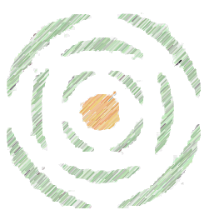
CyVerse Evolution
iPlant 2008
Empowering a New
Plant Biology
iPlant 2013
Cyberinfrastructure for
Life Science
CyVerse 2016
Transforming Science Through Data-Driven Discovery

Slide 5
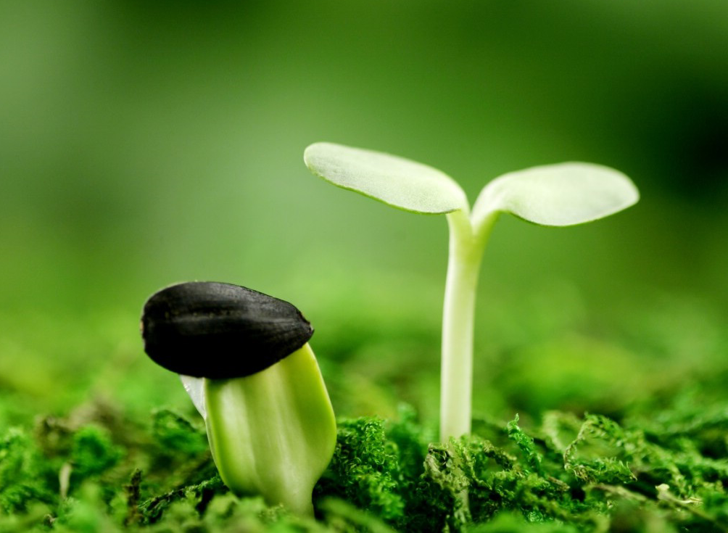
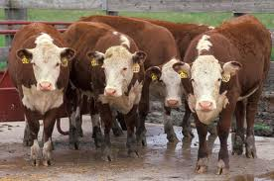
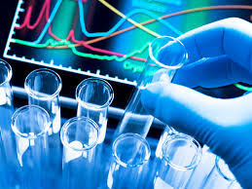

CyVerse is Built for Data
Plant / Microbial Animal Biomedical Ecological/Climate
CyVerse supports all domains of life science

Slide 6

CyVerse Evolution
We are funded by the National Science Foundation
We are your colleagues and collaborators!
$100 Million in investment
Freely available to the community
Spur national/international collaboration
Cite CyVerse:
CyVerse.org/acknowledge-cite-cyverse
DBI-0735191 and DBI-1265383

Slide 7
What is Cyberinfrastructure?

Slide 8
Cyberinfrastructure for Data-intensive Biology
Data storage
Software
High-performance computing
People
organized to solve problems of size and scope not otherwise solvable.

Slide 9
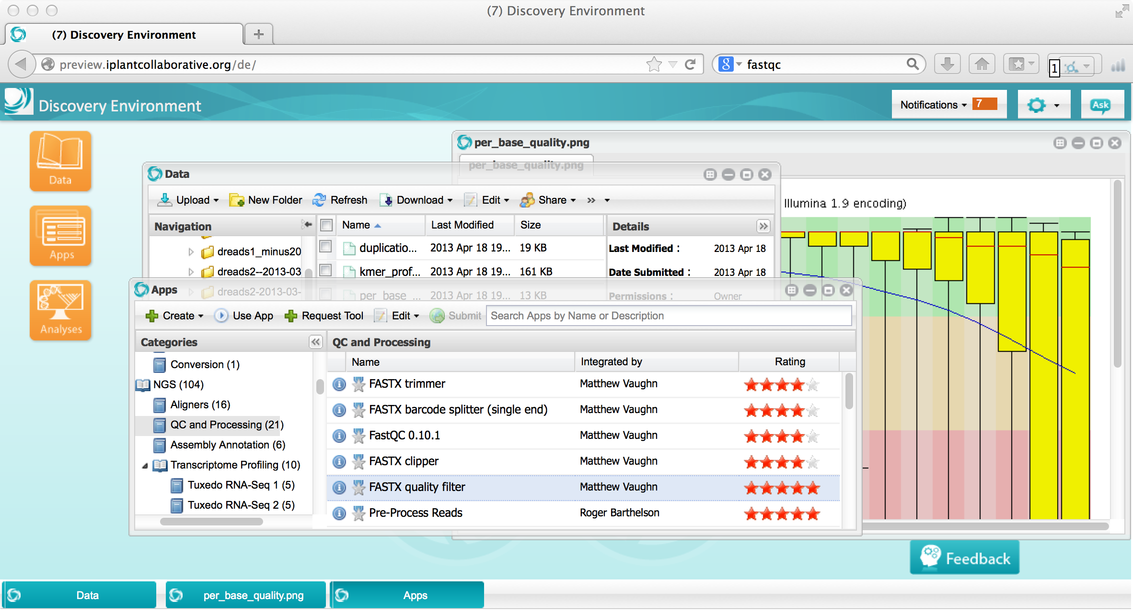
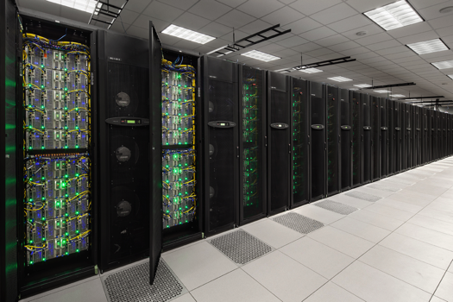
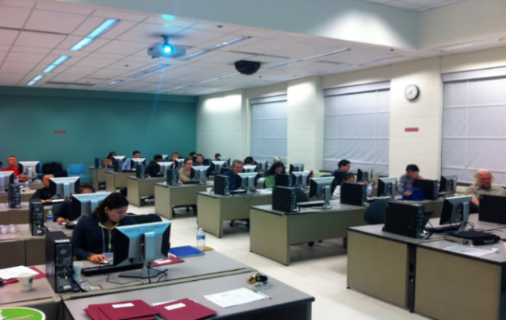
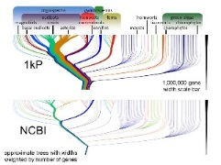
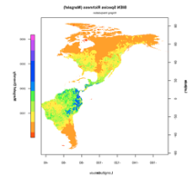
Cyberinfrastructure for Data-intensive Biology
Platforms, tools, datasets Storage and compute Training and support

Slide 10
What is available in CyVerse?

Slide 11
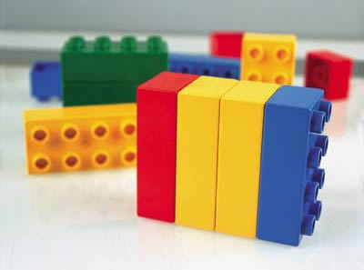
CyVerse Products
We strive to be the CI Lego blocks
Danish 'leg godt' - 'play well’
Also translates as 'I put together' in Latin
If a solution is not available you can craft your own using CyVerse CI components

Slide 12



CyVerse Features
Get Science Done
Ability to access and manage data
Software to analyze data
Computing resources
Skills and help to use software and interpret results
Ensure Reproducibility
Metadata management
Ability to share data and workflows
Open source sustainable tools
Increase Productivity
High-performance and scalable computing
Ability automate and collaborate
Funding spent on science, not software or hardware

Slide 13
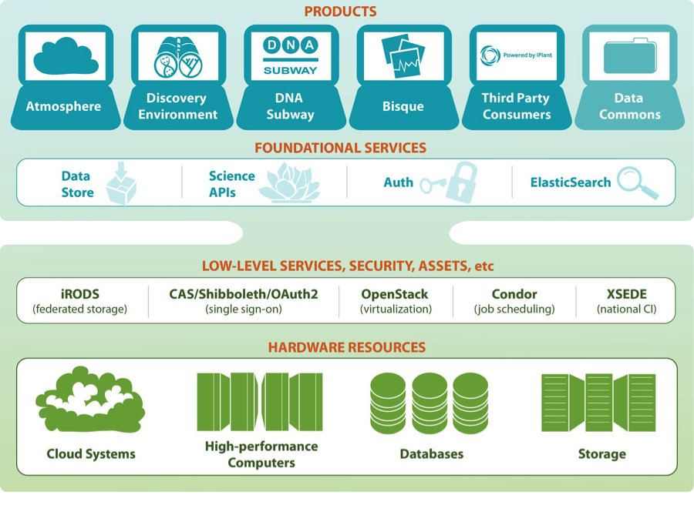
CyVerse product stack
Ready to use Platforms
Extensible Services
Flexibility
Ease of Use
Established CI Components
Foundational Capabilities

Slide 14

Data Store
The resources you need to share and manage data with your lab, colleagues and community
Initial 100 GB allocation – TB allocations available
Automatic data backup
Easy upload /download and sharing
Notes:
Focus here is on genomics data, but not restricted to genomics data

Slide 15

Discovery Environment
Hundreds of bioinformatics Apps in an easy-to-use interface
A platform that can run almost any bioinformatics application
Seamlessly integrated with data and high performance computing
User extensible – add your own applications
Notes:
Focus here is on genomics data, but not restricted to genomics data

Slide 16

Atmosphere
Cloud computing for the life sciences
Simple: quick access to hundreds of virtual machine images
Flexible: fully customize your software setup
Powerful: integrated with CyVerse computing and data resources
Notes:
Focus here is on genomics data, but not restricted to genomics data

Slide 17

Science APIs
Fully customize CyVerse resources
Science-as-a-service platform
Define your own compute, and storage resources (local and CyVerse)
Build your own app store of scientific codes and workflows
Notes:
Focus here is on genomics data, but not restricted to genomics data

Slide 18

DNA Subway
Educational workflows for Genomes, DNA Barcoding, RNA-Seq
Commonly used bioinformatics tools in streamlined workflows
Teach important concepts in biology and bioinformatics
Inquiry-based experiments for novel discovery and publication of data
Notes:
Focus here is on genomics data, but not restricted to genomics data

Slide 19

Bisque
Image analysis, management, and metadata
Secure image storage, analysis, and data management
Integrate existing applications or create new ones
Custom visualization and image handling routines and APIs
Notes:
Focus here is on genomics data, but not restricted to genomics data

Slide 20
How can you do science in CyVerse?

Slide 21
CyVerse Data Commons
Making data discoverable and reusable
Data Store architecture is built for metadata management
Data within CyVerse maintains provenance and can be labeled using a variety of metadata templates or using custom schemas
Direct submission of sequencing data to NCBI Sequence Read Archive
Request DOIs and ARKs (Archival Resource Key) for permanent data identification
Support for elastic search, data sharing, and anonymous access

Slide 22
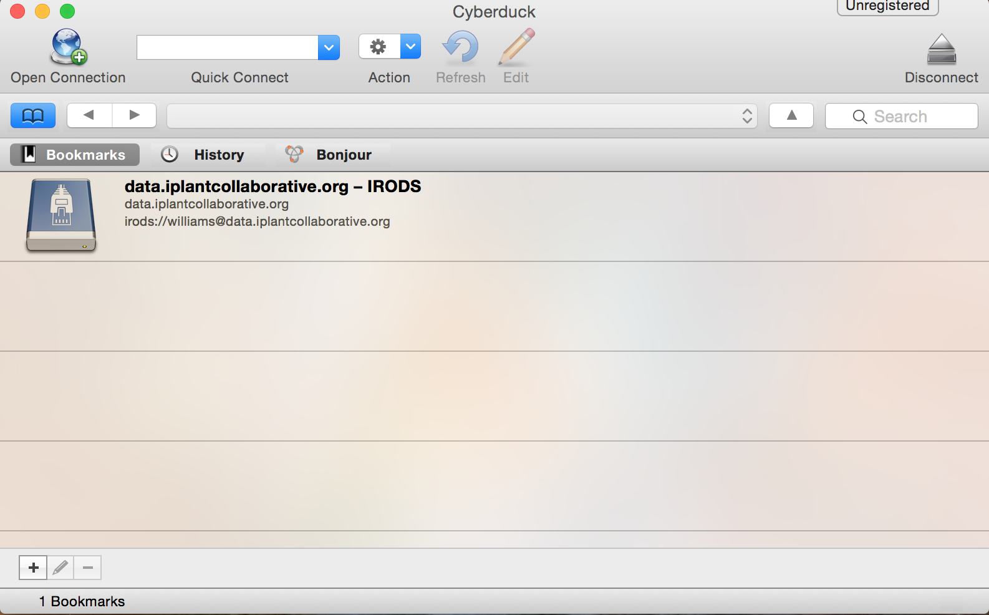
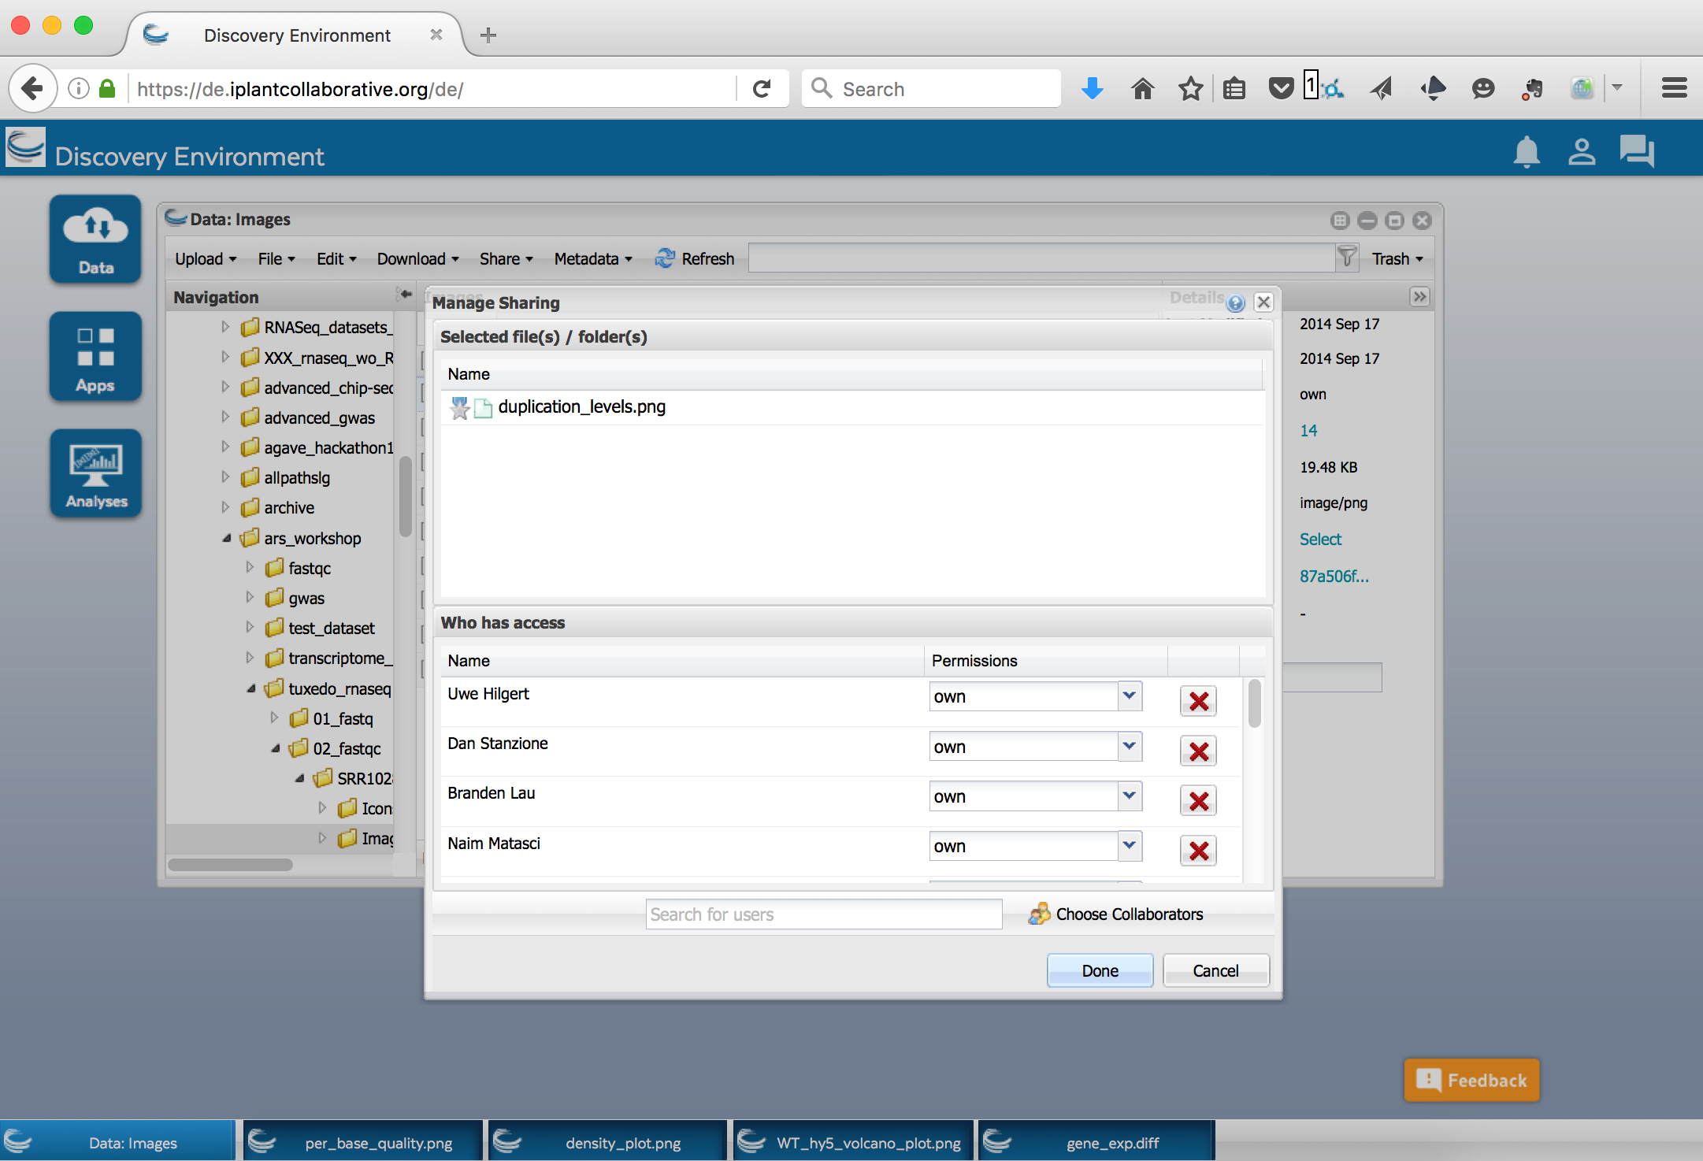
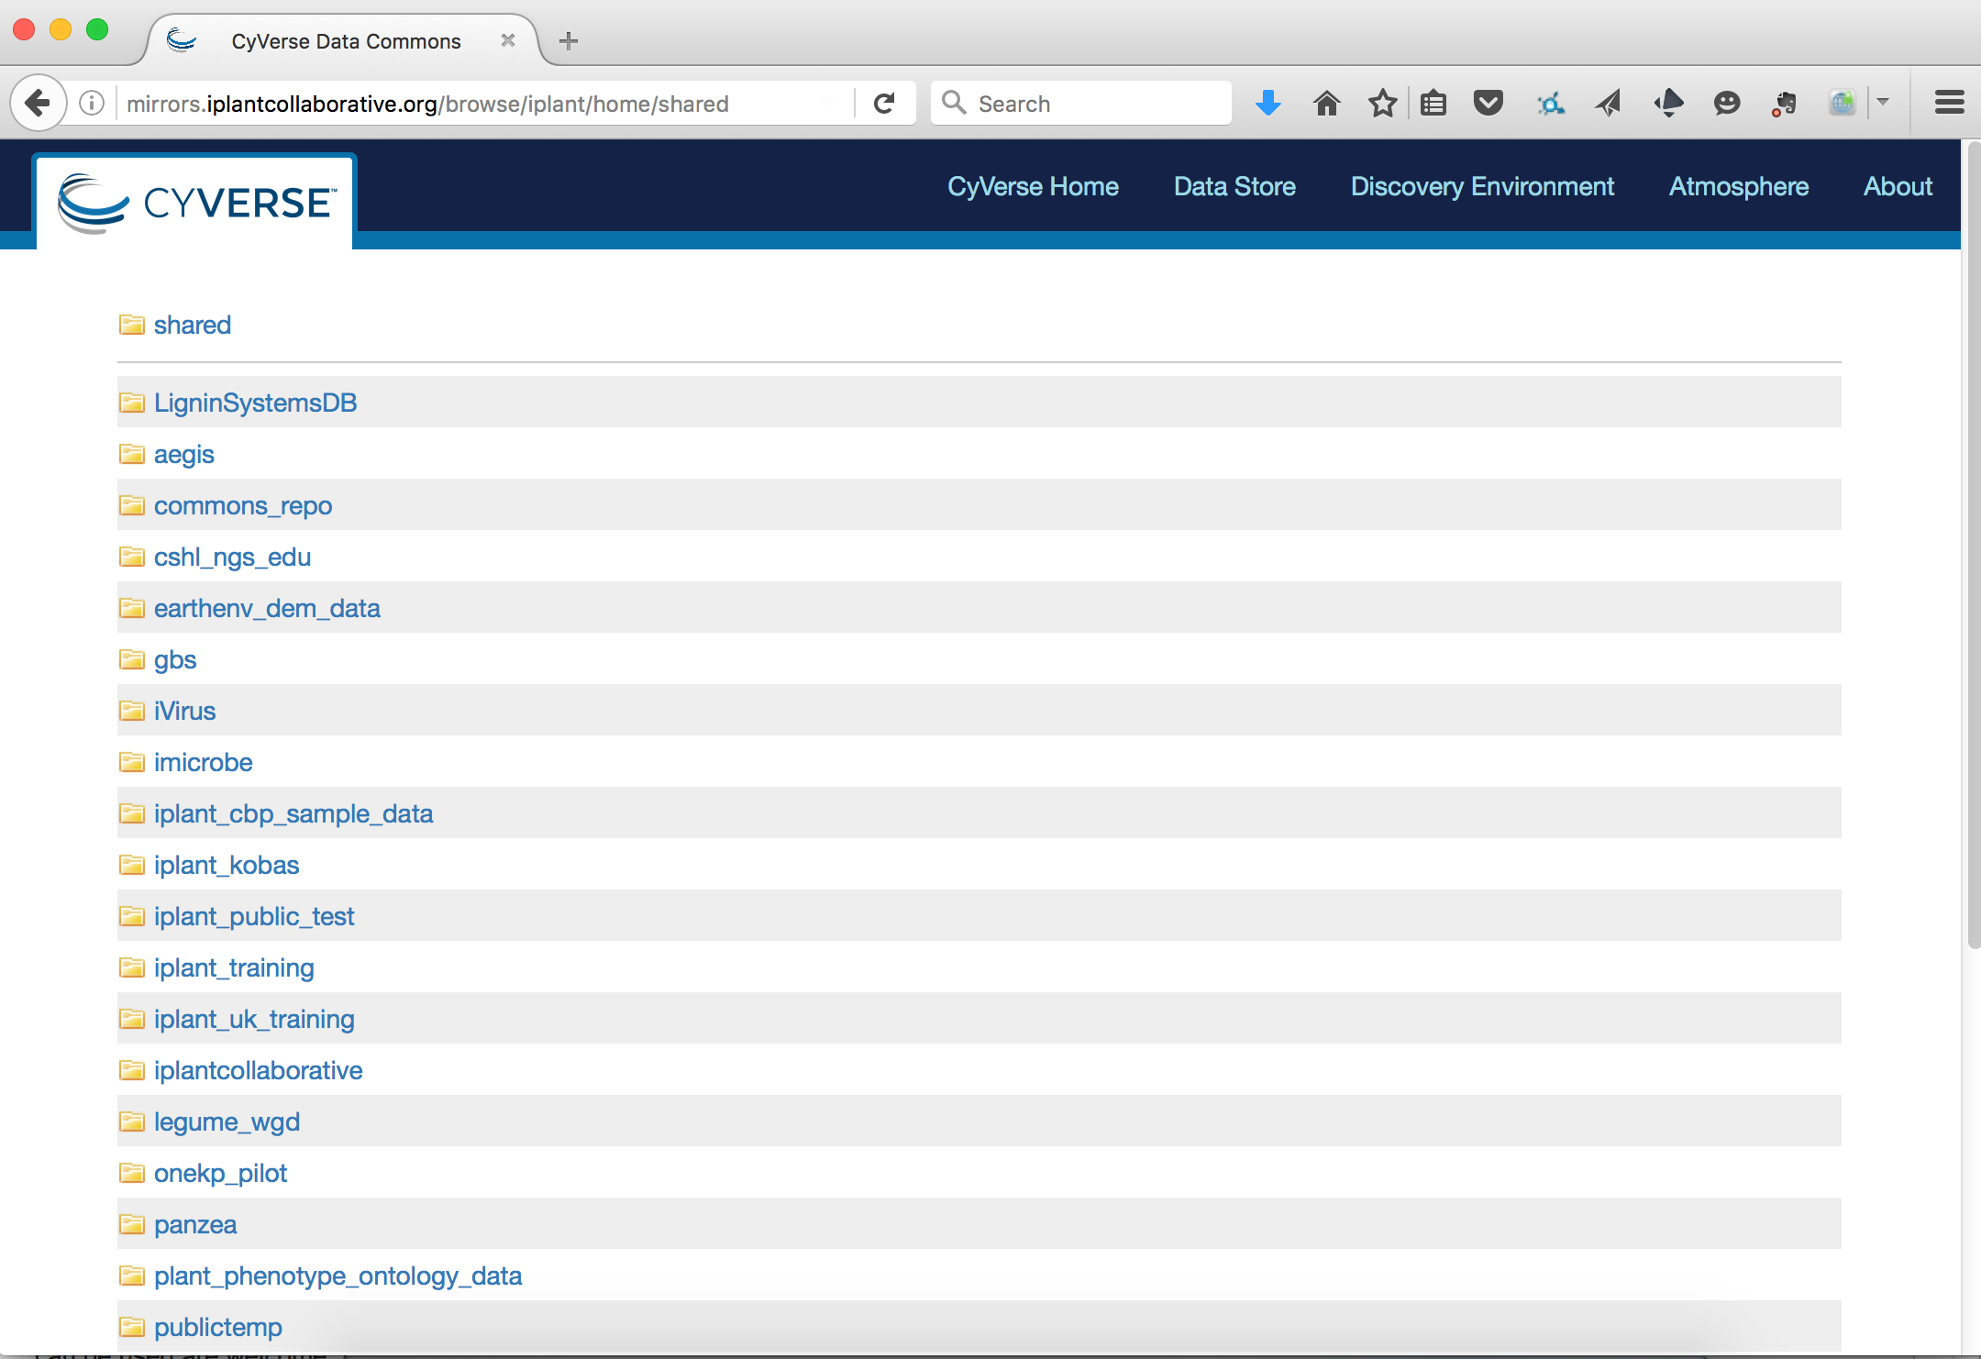
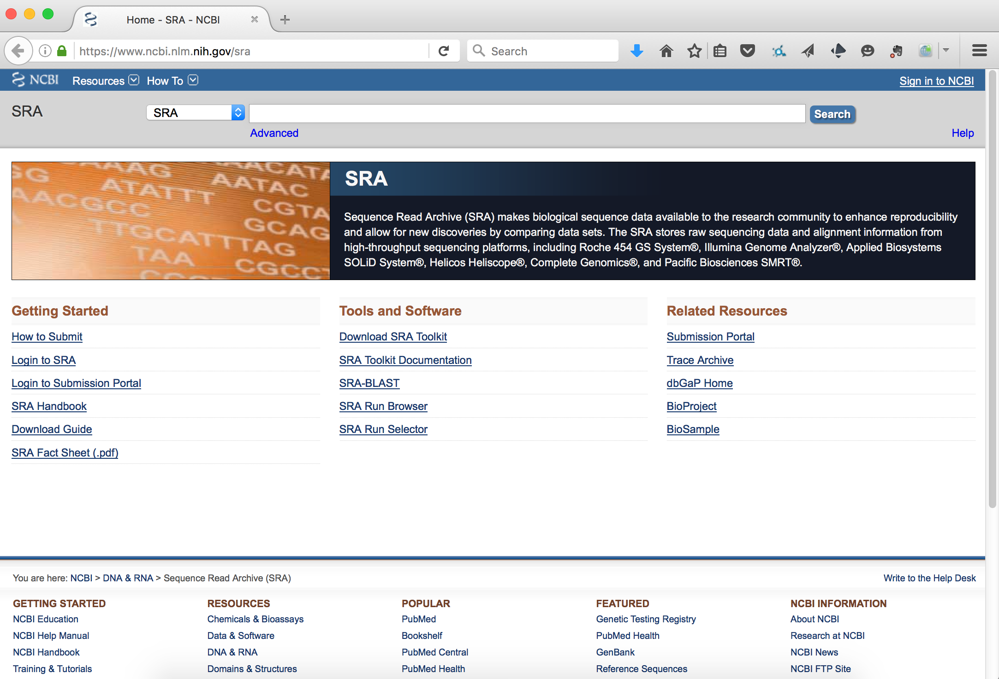
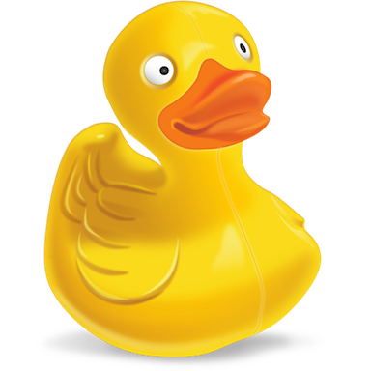
CyVerse Data Commons
Supporting the lifecycle of data
Simple upload
markup, search, share
publish

Slide 23
Discovery Environment
End-to-end workflows for genomics
RNA-Seq 1: Differential Expression
RNA-Seq 2: High-throughput
Genome Assembly
Transcriptome Assembly
WQ-Maker Annotation
Association Studies

Slide 24
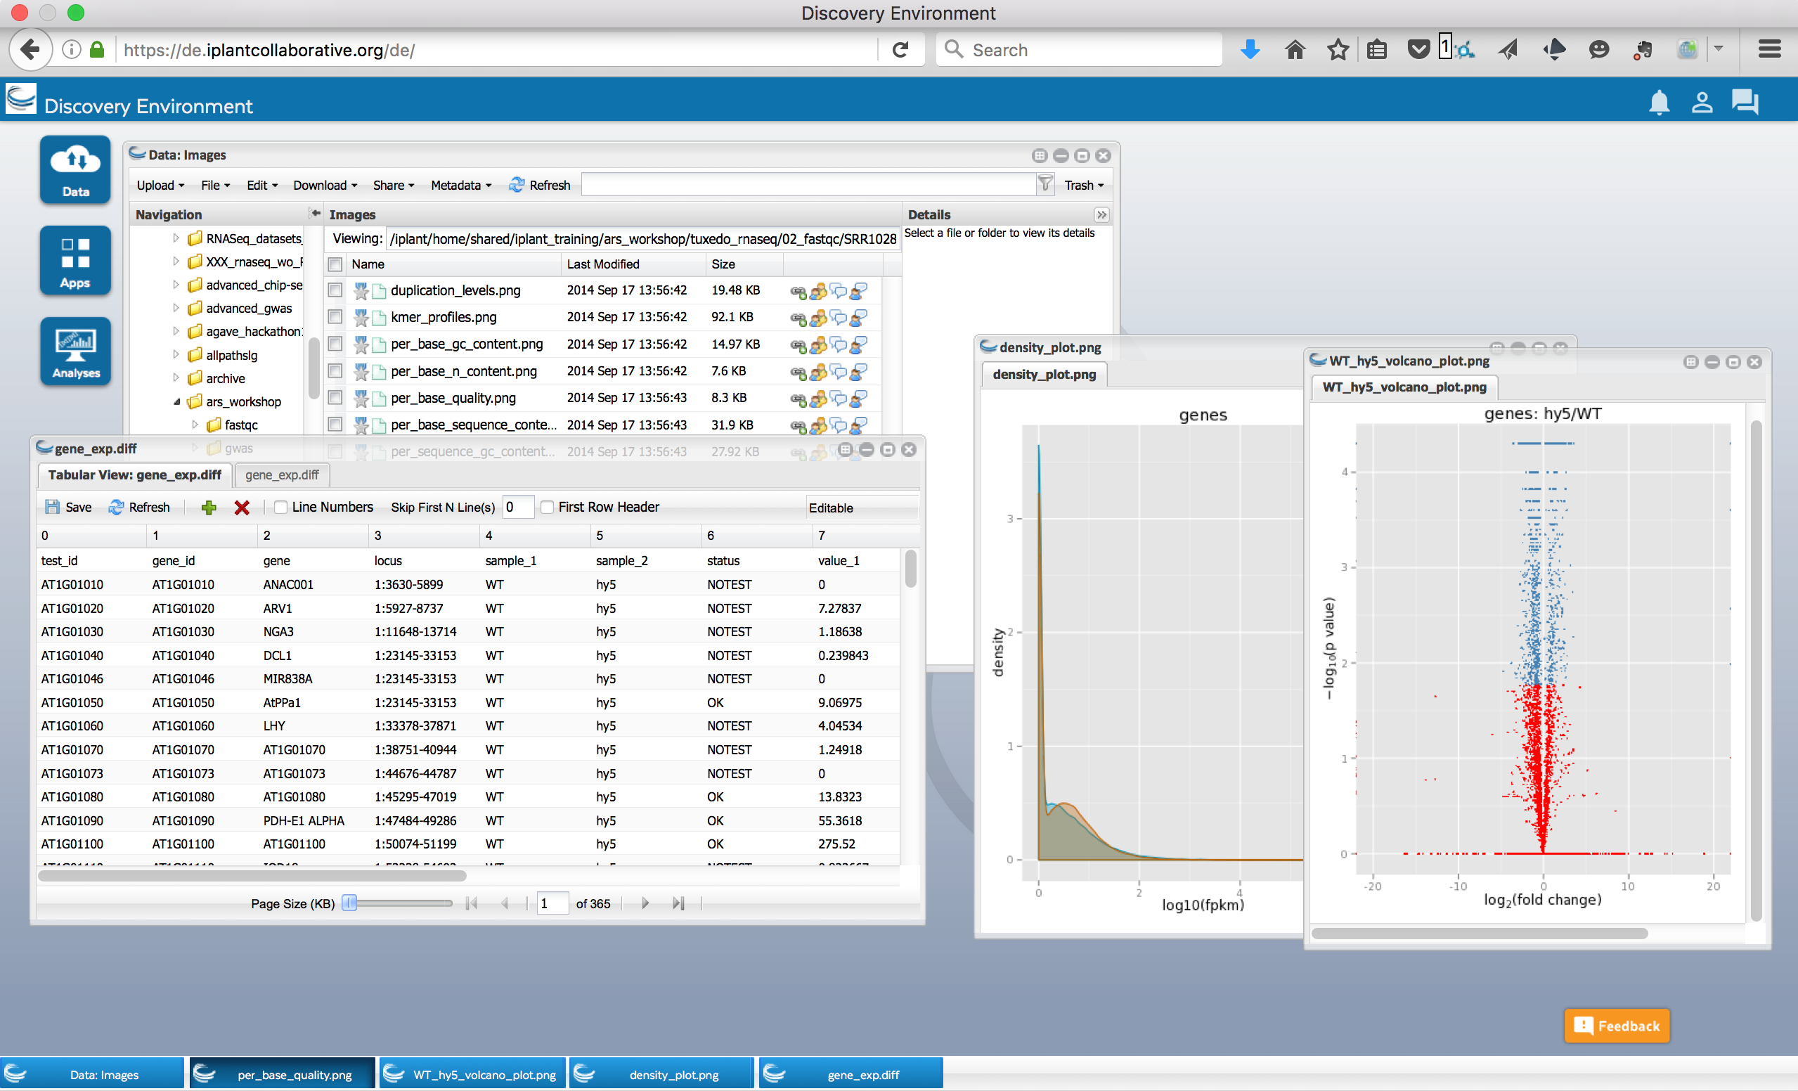


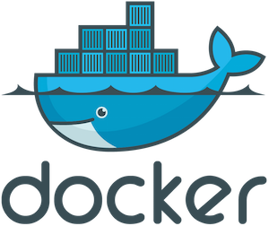

Discovery Environment
User friendly, developer friendly
CyVerse Platforms
The Agave Platform
API
XSEDE Supercomputing
External cloud systems

Slide 25
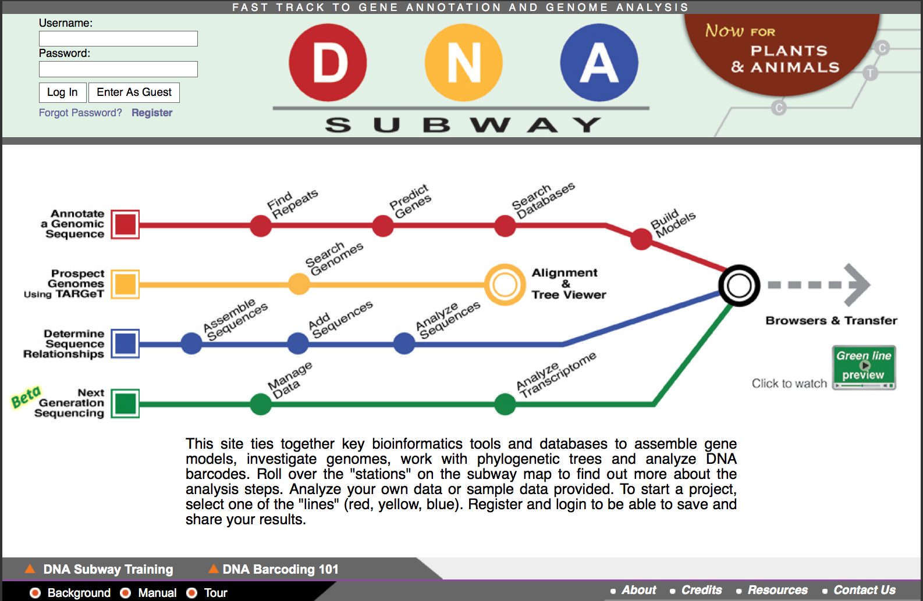
DNA Subway
Classroom applications
Classroom-friendly RNA-Seq workflows
More than 900Gbs Student-faculty projects analyzed in 36 genomes
Online educational materials
DNA Barcoding workflow
~10,000 student-analyzed barcodes and 125 novel NCBI submissions
Online educational materials

Slide 26
How can I use CyVerse?

Slide 27

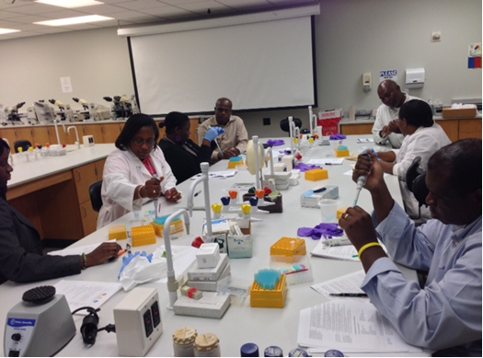
Hands-on training
Workshops that reach users where they are
Tools & Services
Genomics in Education
Two days; targeted to researchers
Hands-on learning modules tailor to interests
Individual consultations
1026 participants since 2011
Two days; targeted to educators
Pair bioinformatics with classroom labs
Help for generating lesson plans
748 participants since 2010

Slide 28
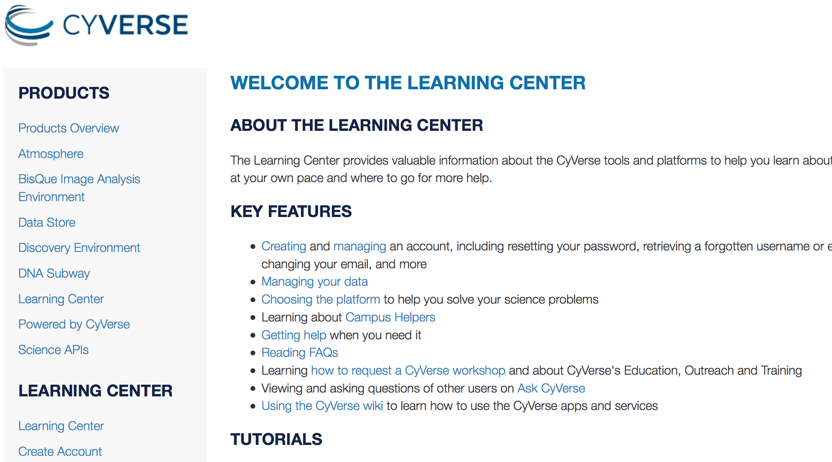
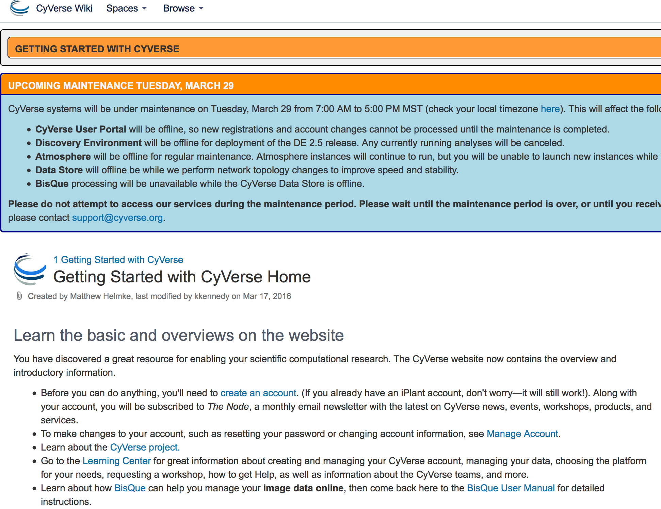
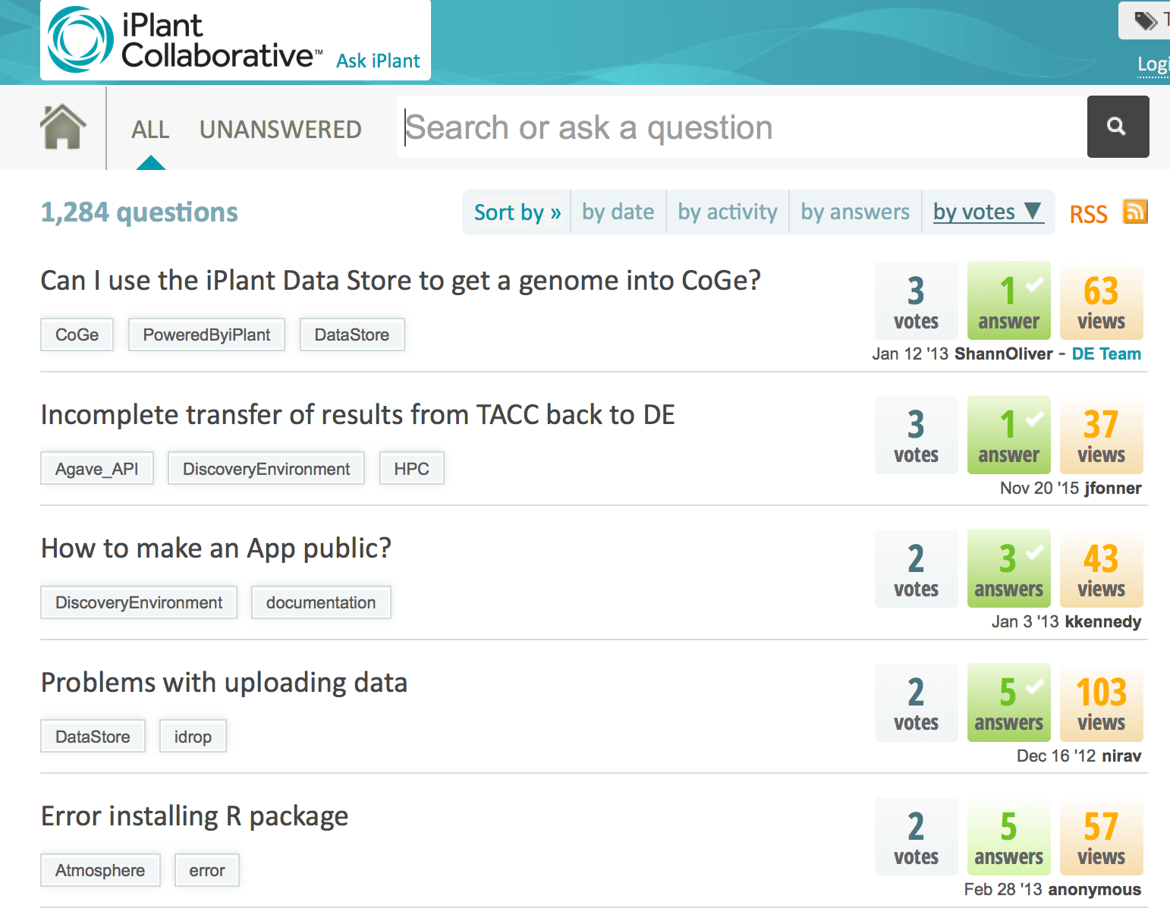
Online learning materials
Documentation, tutorials, and help
Learning Center
Wiki
Forum
cyverse.org/learning-center
Tutorials and quick-starts
wiki.cyverse.org
Documentation
ask.iplantcollaborative.org
Community help/Q&A

Slide 29
CyVerse Executive Team

Slide 30
Getting Data into CyVerse

Slide 31
CyVerse Data Store
Store any type of file related to your research
Move files seamlessly between CyVerse platforms
Automate file transfers
Share files with lab members, collaborators, and communities

Slide 32
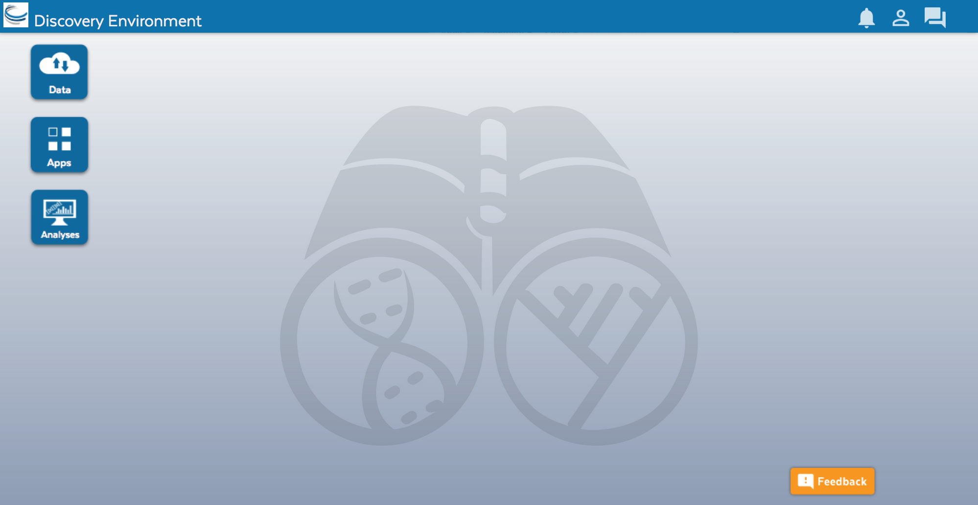
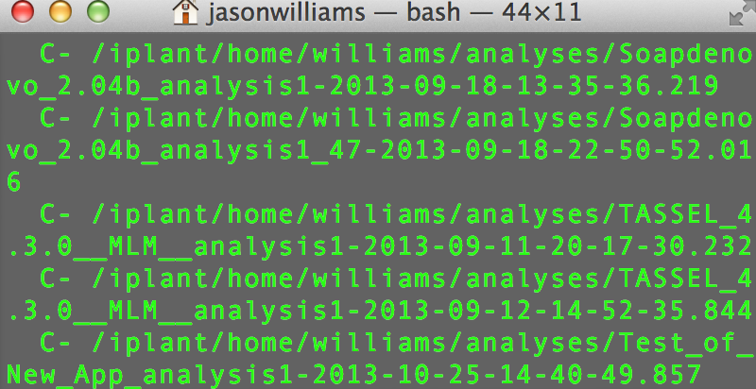
CyVerse Data Store
Multiple ways to access
Point-and-click
Command line
Cyberduck Discovery Environment
iCommands

Slide 33
Discovery Environment
Simple upload/download for small files
Bulk upload files and folders (<10GB)
Import from URL (no size limit)
Advantage + Disadvantage -
Covers most upload/download sharing needs
Some size/speed limitations

Slide 34
Cyberduck
Drag and drop files and folders
No size limit, file editing/previews
Easy Desktop functionality
Advantage + Disadvantage -
More like desktop file systems
No permissions/metadata control

Slide 35
iCommands
Full flexibility
Ability to script and automate
Access from terminal/server
Advantage + Disadvantage -
Customizability
Requires some command line expertise

Slide 36
Cyberduck and iCommands Demo

Slide 37
Discovery Environment

Slide 38
Discovery Environment
A platform that can run almost any bioinformatics application
Seamlessly integrated with data and high performance computing
User extensible – add your own applications

Slide 39
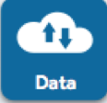
Discovery Environment Overview
Manage data
Data
Upload / Download files and folders
Share files via URL (Public Links)
Share files/folders with other users

Slide 40
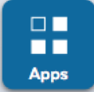
Discovery Environment Overview
Analyze data and customize Applications
Apps
Run hundreds of bioinformatics Apps
Build automated workflows
Modify Apps or integrate new ones

Slide 41
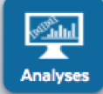
Discovery Environment Overview
View history, find results, reproduce analyses, optimize parameters
Analyses
Monitor job status and find results
Cancel jobs or re-launch jobs
Detailed job history

Slide 42
Discovery Environment Demo

Slide 43
Discovery Environment
Demo analysis – sequence alignment using MUSCLE
Task: Take unaligned DNA sequences in FASTA format and create a multiple alignment
View sample data in iPlant Data Store
Launch a job using the MUSCLE sequence alignment app
Monitor the job progress and view results

Slide 44
Atmosphere

Slide 45
Atmosphere
Simple: 1-click access to hundreds of virtual machine images
Flexible: Fully customize your software setup
Powerful: Integrated with CyVerse computing and data resources

Slide 46
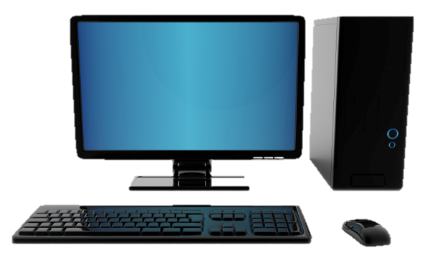


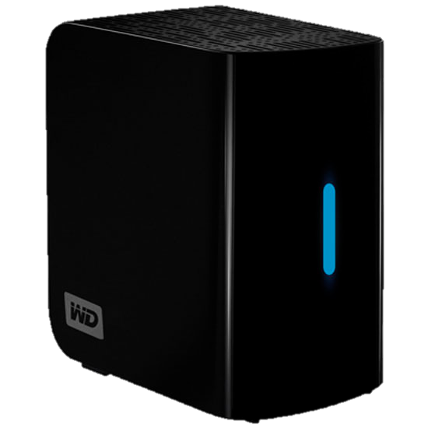
What is Cloud Computing?
Important concepts: Image
Image (file)
Complete clone (files/data)
Original system
Document(s) (file)
Copied Document(s) (file)

Slide 47
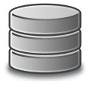
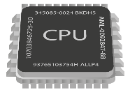
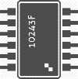
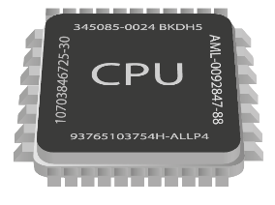

What is Cloud Computing?
Important concepts: Instance
+
(Disk + CPU + Memory) + (Image)
128.196.34.158
CyVerse Cloud
Atmosphere Instance
(virtual machine)

Slide 48
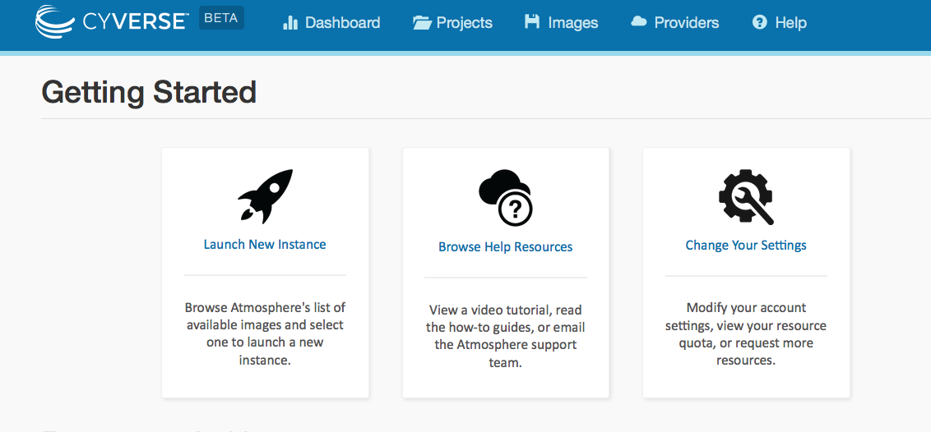
Atmosphere Overview
Largest, easiest to use cloud for Life Sciences
Choose an existing image or customize
Instances up to 16-Core / 128 GB RAM
Access via shell or VNC
Share you image with selected users, or make them public

Slide 49
Atmosphere
Cloud computing for life sciences: sample use cases
Run the software and data that are monopolizing your laptop/desktop
Use desktop enabled images to run visually oriented programs (GUI)
SUDO access – manage complex dependencies
Uniform computing setups for your lab, collaborators, and students
Make your own software available to a larger user community

Slide 50
Atmosphere Demo

Slide 51

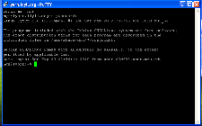
Atmosphere
Cloud computing for life sciences
Windows Mac Linux
128.196.65.175
VNC Viewer
VNC Viewer
VNC Viewer
PuTTY
Shell/terminal
Shell/terminal
VNC Viewer: www.realvnc.com/download/viewer
PuTTy: www.putty.org

Slide 52
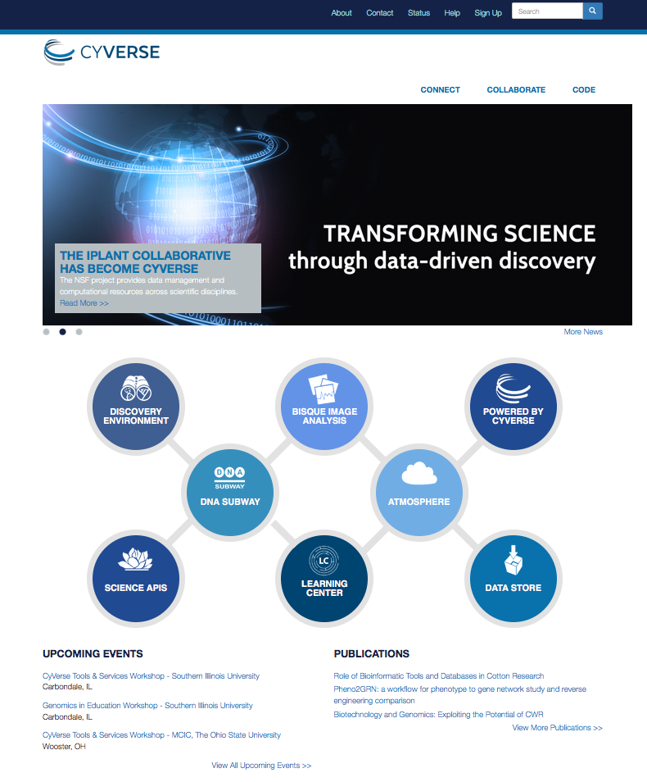
Where to go from here:
Learning Center
Get Started Guide
Tutorials and Videos
Documentation
Upcoming Events
Workshops
Webinars

Slide 53
Slides and Tutorials
www.cyverse.org/sol2016

